Slide 1
Strings
In programming terms, text is usually called string.
A Python string is a sequence, which consists of zero or more characters.
String is an immutable data structure, which means they cannot be changed.
String is one of the most important data type in Python.
String can be a single character or a combination of different characters.
String literals in python are surrounded by either single quotation marks, or double quotation marks.
'hello' is the same as "hello".
Examples
>>> greetings = "Hello, World!" >>> print(greetings)
Hello, World!

Slide 2
Strings
String is an immutable data structure, which means they cannot be changed.
Cannot edit the value of the variable although you can reassign it.
>>> name = “Ali Danish" >>> name
Ali Danish
>>> name = “Jibran”
Jibran

Slide 3
Length and Concatenation of Strings
To find the length of the string, len() function is used
To join or concatenate strings, use the ‘+’ operator on strings
>>> name = "Ali Danish"
>>> name
'Ali Danish'
>>> len(name)
10
>>> name = "Ali Danish"
>>> prefix = "Mr. “
>>> prefix + name
'Mr. Ali Danish‘

Slide 4
Subscript Operator
The subscript operator is defined as square brackets [].
It is used to access the elements of string, list tuple, and so on.
Syntax with index
<string>[index]
>>> name = "The Avengers"
>>> len(name)
12
>>> name[0]
'T'
>>> name[11]
's'

Slide 5
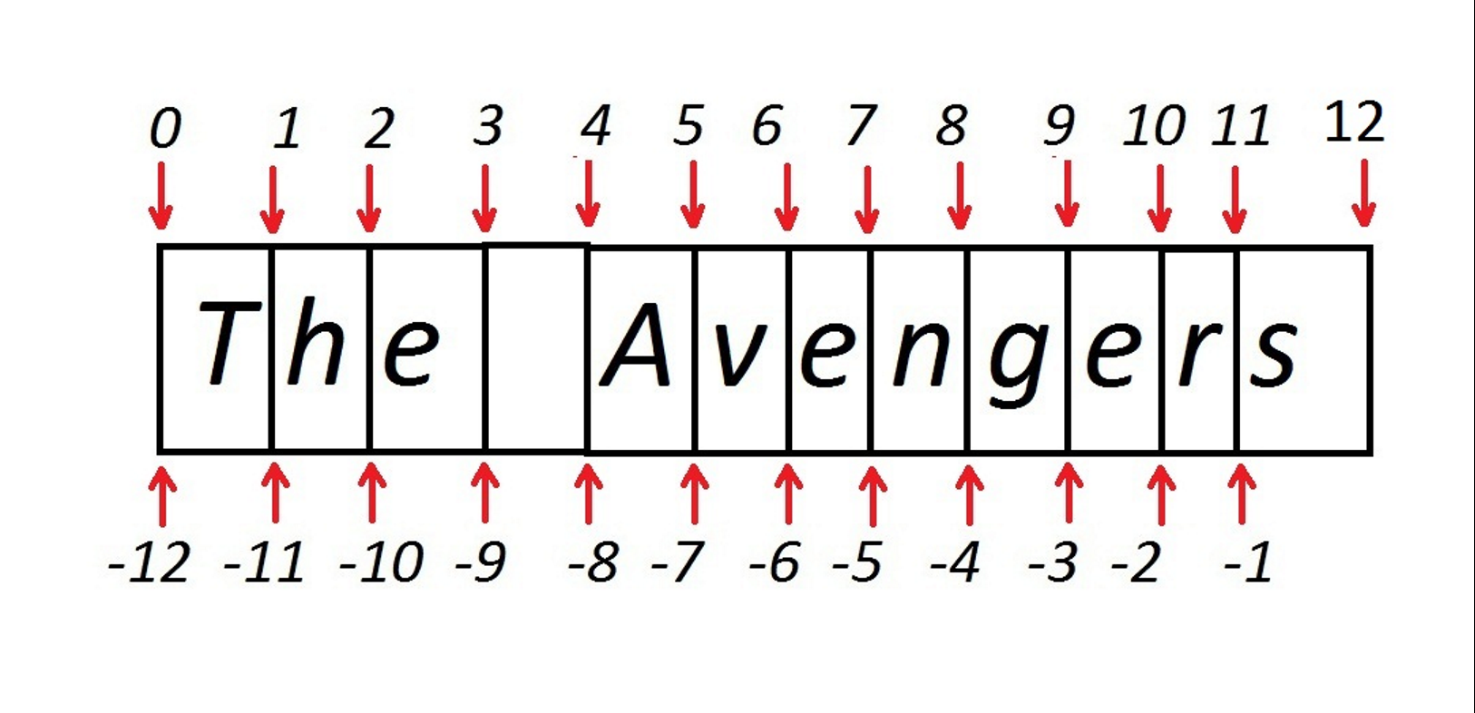
Slicing
Negative Indexing
>>> name = "The Avengers"
>>> name[-1]
's'
>>> name[-12]
'T'
>>> name[::-1]
'sregnevA ehT'

Slide 6
Slicing and Dicing
>>> name
'The Avengers'
>>> name[0:3]
'The‘
>>> name[:6]
'The Av'
>>> name[:]
'The Avengers'
>>> name[5:9]
'veng'
>>> name[::2]
'TeAegr'

Slide 7
String Case Methods
name = “Hello Ali”
Method | Expression | Result
upper() | name.upper() | 'HELLO ALI’
lower() | name.lower() | 'hello ali'
capitalize() | name.capitalize() | ‘Hello ali'
swapcase() | name.swapcase() | 'hELLO aLI'
title | name.title() | 'Hello Ali'

Slide 8
String Strip Methods
name = “*Dr Maqsood##”
Method | Expression | Result
lstrip() | name.rstrip() | 'Dr Maqsood##'
rstrip() | name.lstrip() | '*Dr Maqsood'
strip() | name.strip() | 'Dr Maqsood'

Slide 9
Split Method
Syntax: str.split(“delimiter”, num)
Split based on delimiter ‘-’
>>> str1 = "27-12-2016"
>>> str1.split("-“)
['27', '12’,’2016']
Split based on default space
>>> name = “Sikandar Raja"
>>> name.split()
[‘Sikandar', ‘Raj']

Slide 10
Replace Method
syntax: str.replace(old, new max)
Relace returns copy of string with old characters are replaced with new ones
>>> strDate = "27-12-2016"
>>> text = "time is great and time is money"
>>> text.replace("is","was")
'time was great and time was money‘

Slide 11
Join Method
syntax: str.join(seq)
seq contains sequence of separated strings here str acts as a separator.
>>> fullname = [“Abdul",“Malik"]
>>> " ".join(fullname)
‘Abdul Malik'

Slide 12
String Boolean Methods
endswith method
syntax: str.endswith(sub-string, begin,end]
>>> text = "Life should be great rather than long“
>>> text.endswith("ng")
True
>>> text.endswith("er")
False
>>> text.endswith("er",0,27)
True

Slide 13
String Boolean Methods
startswith method
syntax: str.startswith(sub-string, begin,start]
>>> quote = "Life should be great rather than long“
>>> quote.startswith("Li")
True
>>> quote.startswith("be", 11)
False
>>> quote.startswith("be", 12, 16)
True

Slide 14
More Boolean Methods
isalnum()
isdigit()
isspace()
islower()
Isupper()

